Slide 1

CAP 6317/4773: Social Media Mining
Lecture 13: Data Mining
Raiyan Abdul Baten, Ph.D.
February 22, 2024

Slide 2
Recap

Slide 3

Choosing the right statistical tests
Factors | Levels | Within/Between | Parametric Test | Non-parametric Test
1 | 2 | Between | Independent sample t-test | Mann-Whitney U test
1 | 2 | Within | Paired sample t-test | Kruskal-Wallis test
1 | >2 | Between | One-way ANOVA | Wilcoxon Signed-rank test
1 | >2 | Within | One-way Repeated Measures ANOVA | Friedman test
Parametric test: Makes assumptions about the distribution of population from which the sample was taken
Non-parametric test: Makes no such assumption

Slide 4
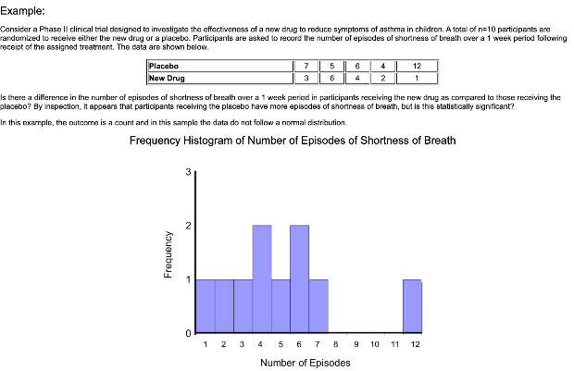
When do we choose nonparametric tests?
Data is skewed – doesn’t follow normal distribution (or any other distribution assumptions)
Pro tip: Count values typically do not follow the normal distribution
Sample size is too small

Slide 5

When do we choose nonparametric tests?
Data is skewed – doesn’t follow normal distribution (or any other distribution assumptions)
Pro tip: Count values typically do not follow the normal distribution
Sample size is too small
Data is ordinal or categorical
E.g.: Likert scale

Slide 6
Choosing the right statistical tests
Factors | Levels | Within/Between | Parametric Test | Non-parametric Test
1 | 2 | Between | Independent sample t-test | Mann-Whitney U test
1 | 2 | Within | Paired sample t-test | Kruskal-Wallis test
1 | >2 | Between | One-way ANOVA | Wilcoxon Signed-rank test
1 | >2 | Within | One-way Repeated Measures ANOVA | Friedman test
>1 | ≥ 2 | Between | Factorial ANOVA, Linear Model | Aligned Rank Transform (ART)
>1 | ≥ 2 | Within | Factorial Repeated Measures ANOVA, Generalized Linear Model | ART/ Generalized Linear Mixed Model

Slide 7
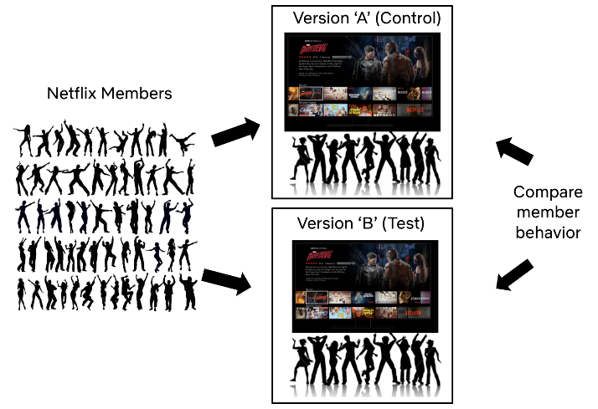
Source: https://netflixtechblog.com/experimentation-is-a-major-focus-of-data-science-across-netflix-f67923f8e985

Slide 8
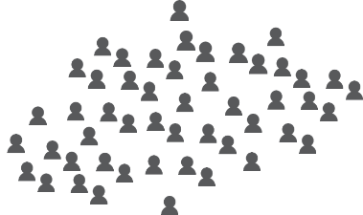
A/B testing on a social media platform
Condition A
Condition B
The recommendation engine is the independent variable (factor), it has two levels (A and B). We make observations of user behavior (dependent variable) in each condition

Slide 9
A/B testing on a social media platform
Age 25-40
Age 25-40
Age 18-25
Age 18-25
Age 40+
Age 40+
Condition A
Condition B
Add a second independent variable (factor): Age, with three levels (18-25, 25-40, 40+)
Now we have a 2x3 factorial design:
Recommendation engine (2 levels) x Age (3 levels)

Slide 10
Viewing duration
18-24
25-40
41+
18-24
25-40
41+
Condition A
Condition B

Slide 11
Choosing the right statistical tests
Factors | Levels | Within/Between | Parametric Test | Non-parametric Test
1 | 2 | Between | Independent sample t-test | Mann-Whitney U test
1 | 2 | Within | Paired sample t-test | Kruskal-Wallis test
1 | >2 | Between | One-way ANOVA | Wilcoxon Signed-rank test
1 | >2 | Within | One-way Repeated Measures ANOVA | Friedman test
>1 | ≥ 2 | Between | Factorial ANOVA, Linear Model | Aligned Rank Transform (ART)
>1 | ≥ 2 | Within | Factorial Repeated Measures ANOVA, Generalized Linear Model | ART/ Generalized Linear Mixed Model
One test to rule them all! Can even handle missing data, and any mixture of Within-Between subjects designs in different factors. First do omnibus, then do pairwise tests with corrections.

Slide 12
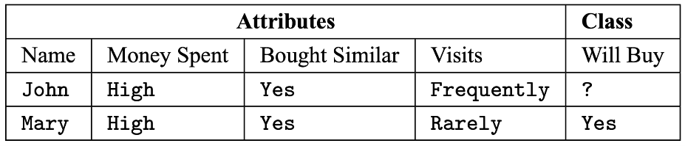
Supervised Learning
Regression: Target variable is continuous-valued
Classification: Target variable is discrete-valued

Slide 13
A closer look into data/feature types
Nominal/categorical
Names of things
Race
Marital status: Single, married, divorced, widowed
Hair color
Occupation
Chi-squared tests/mode can be meaningful

Slide 14

A closer look into data/feature types
Ordinal
Values have a meaningful order, but the magnitude between successive values is not specified
Likert Scale, drink size, professional rank
0: very dissatisfied, 1: somewhat dissatisfied, 2: neutral, 3: satisfied, 4: very satisfied
Small, medium, large
Assistant professor, Associate professor, Full professor
Non-parametric tests can be useful

Slide 15
A closer look into data/feature types
Numeric: (a) Interval
Intervals between units have an equal size
There is no true 0
Ratios don’t make any sense
Calendar dates, temperatures in Celcius/Fehrenheit scales
Year 0 doesn’t mean the beginning of time
0 degree Celsius doesn’t mean no temperature
6:16 PM is not the double of 3:08 PM

Slide 16
A closer look into data/feature types
Numeric: (b) Ratio
True 0 exists: Kelvin scale of temperature
Count values: years of experience, number of words
4 years is double the experience than 2 years
2000 words is double of 1000 words

Slide 17
Data Preprocessing
Dealing with missing values
Ignore!
Fill in missing values manually
Use a global constant: ‘unknown’ or -inf
Use mean, median, or mode
Use mean, median, or mode from the same class
Use the most probable value using a learning algorithm

Slide 18
Data Preprocessing
Remove redundant features
Numeric data: Pearson’s correlation coefficient
If two features are highly and significantly correlated, they have redundant information

Slide 19
Data Preprocessing
Remove redundant features
Nominal/categorical data: Chi-squared test!
 | Male | Female | Total
Fiction | 250 (90) | 200 (360) | 450
Non-fiction | 50 (210) | 1000 (840) | 1050
Total | 300 | 1200 | 1500
Compare the Chi-square value against the Chi-square distribution table entry with degree of freedom (c-1)(r-1). If your value is greater than the reference value, you can reject the null hypothesis. Then, we would know that one feature implies the other–potentially indicating redundant information!

Slide 20
Data Preprocessing
Split into training, validation, and test sets
Typically 70 : 10 : 20
Can be 90 : 10 : 10 or 95 : 5 : 5 stricter if you have a lot of data
Random sampling vs stratified sampling
Warning: Beware of data leakage!
If a single user/participant/source contributes multiple data points, make sure that all of those data points are in the same training/validation/test set

Slide 21
Regression Modeling
Linear regression – Ridge
Linear regression – LASSO
ElasticNet regression
Bayesian regression
Support Vector regression
Random Forest
AdaBoost
XGBoost

Slide 22
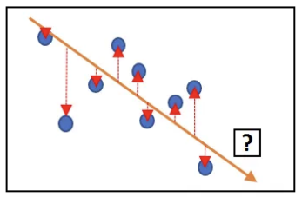



Simple Linear Regression
We want to learn w₀ and w₁. Consider the i-th data point,
The residual sum of squares, RSS, is given by,
We want to find w₀ and w₁ that minimize the RSS:

Slide 23


Simple Linear Regression
We want to find w₀ and w₁ that minimize the RSS:
Taking the derivatives with respect to w₀ and w₁ :
To find the closed form solutions, set the gradients to 0:

Slide 24
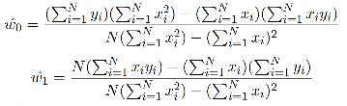
Simple Linear Regression
To find the closed form solutions, set the gradients to 0:

Slide 25
Reminder to self: Attendance

Slide 26
Supervised Learning

Slide 27

Simple Linear Regression
Alternatively, use Gradient Descent:
Let w = [w₀ , w₁ ]^{T}
If a multivariable function F(w) is defined and differentiable in a neighborhood of a point w, then F(w) decreases fastest if one goes from w in the direction of the negative gradient of F(w).
w^{(t+1)} = w^{(t)} - ∇F(w)
w₁
w₀

Slide 28
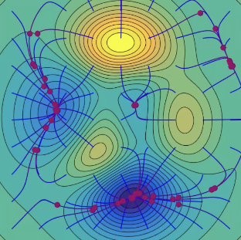
Simple Linear Regression
Let w = [w₀ , w₁ ]^{T}
In our case, we want to find w such that the function RSS(w) is minimized.
w₁
w₀

Slide 29
Simple Linear Regression
Let w = [w₀ , w₁ ]^{T}
In our case, we want to find w such that the function RSS(w) is minimized.
At step t, we have estimates of w₀^{(t)} and w₁^{(t)}, denoted as w^{(t)}.
w₁
w₀

Slide 30
Simple Linear Regression
Let w = [w₀ , w₁ ]^{T}
In our case, we want to find w such that the function RSS(w) is minimized.
At step t, we have estimates of w₀^{(t)} and w₁^{(t)}, denoted as w^{(t)}.
In the next step t+1, we want updated estimates w^{(t+1)} so that we’re moving towards the minima of RSS(w^{(t)}). We know that RSS(w^{(t)}) decreases the fastest if we go from w^{(t)} in the direction of the negative gradient of RSS(w^{(t)}).
w^{(t+1)} = w^{(t)} - ∇ RSS(w^{(t)})
w₁
w₀

Slide 31

Simple Linear Regression
Let w = [w₀ , w₁ ]^{T}
In our case, we want to find w such that the function RSS(w) is minimized.
At step t, we have estimates of w₀^{(t)} and w₁^{(t)}, denoted as w^{(t)}.
In the next step t+1, we want updated estimates w^{(t+1)} so that we’re moving towards the minima of RSS(w^{(t)}). We know that RSS(w^{(t)}) decreases the fastest if we go from w^{(t)} in the direction of the negative gradient of RSS(w^{(t)}).
w^{(t+1)} = w^{(t)} - ∇ RSS(w^{(t)})
w₁
w₀

Slide 32
Simple Linear Regression
At t = 1, initialize w⁽¹⁾ = 0 or randomly or smartly
while |∇RSS(w^{(t)})| > threshold:
w₁
w₀

Slide 33

Multi-Regression: Multiple features
Regression model:

Slide 34
Multi-Regression: Multiple features
Regression model:
The residual sum of squares, RSS, is:
The above is a generalization of our previous RSS:

Slide 35
Multi-Regression: Multiple features
Minimize RSS by taking the derivative with respect to w:

Slide 36

Multi-Regression: Multiple features
Minimize RSS by taking the derivative with respect to w:
Set the gradient to 0 to find the closed form solution:

Slide 37
Multi-Regression: Multiple features
Alternatively, use Gradient Descent:
At t = 1, initialize w⁽¹⁾ = 0 or randomly or smartly
while |∇RSS(w^{(t)})| > threshold:

Slide 38
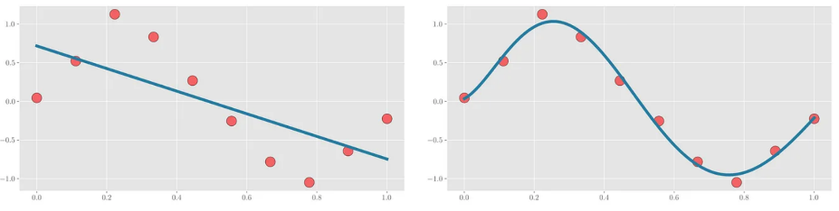
Polynomial Regression

Slide 39
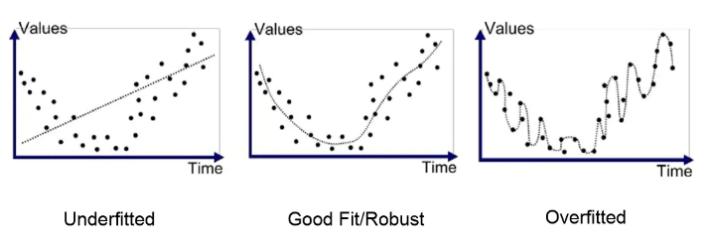
Ridge Regression
When your curve is overfitting (memorizing the datapoints), the curve needs to change steeply, and the coefficient values become large

Slide 40
Ridge Regression
Solution: Penalize large values of coefficients

Slide 41
Ridge Regression
Total cost = measure of fit (RSS) + measure of the magnitude of coefficients

Slide 42
Ridge Regression
Total cost = measure of fit (RSS) + measure of the magnitude of coefficients
Total cost = RSS(w) + λ ( )
Total cos

Slide 43
Ridge Regression
Total cost = measure of fit (RSS) + measure of the magnitude of coefficients
Total cost = RSS(w) + λ ( )
Total cost = RSS(w) + λ w^{T}w

Slide 44
Ridge Regression
Total cost = measure of fit (RSS) + measure of the magnitude of coefficients
Total cost = RSS(w) + λ ( )
Total cost = RSS(w) + λ w^{T}w
We already calculated RSS:

Slide 45
Ridge Regression
Total cost = measure of fit (RSS) + measure of the magnitude of coefficients
Total cost = RSS(w) + λ ( )
Total cost = RSS(w) + λ w^{T}w
We already calculated RSS:
So, the total cost = ( y - Xw )^{T} ( y - Xw ) + λ w^{T}w

Slide 46
Ridge Regression
Total cost = measure of fit (RSS) + measure of the magnitude of coefficients
Total cost = RSS(w) + λ ( )
Total cost = RSS(w) + λ w^{T}w
We already calculated RSS:
So, the total cost = ( y - Xw )^{T} ( y - Xw ) + λ w^{T}w
Taking the gradient of the cost:
∇ ( RSS(w) + λ w^{T}w )

Slide 47
Ridge Regression
Setting the gradient to 0 to find the desired w:

Slide 48

Ridge Regression
Setting the gradient to 0 to find the desired w:

Slide 49
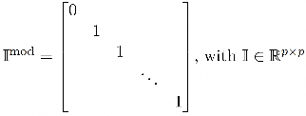
Ridge Regression
Setting the gradient to 0 to find the desired w:
We might not want to penalize the intercept w₀ for being large. Therefore, we can use a modified I^{mod} in the above equation:

Slide 50
Ridge Regression
Alternatively, we can use Gradient Descent:
At t = 1, initialize w⁽¹⁾ = 0 or randomly or smartly
while |∇RSS(w^{(t)})| > threshold:

Slide 51
Ridge Regression
Alternatively, we can use Gradient Descent:
At t = 1, initialize w⁽¹⁾ = 0 or randomly or smartly
while |∇RSS(w^{(t)})| > threshold:
Without the Ridge penalty, the gradient descent update looked like this:

Slide 52
Ridge Regression
Alternatively, we can use Gradient Descent:
At t = 1, initialize w⁽¹⁾ = 0 or randomly or smartly
while |∇RSS(w^{(t)})| > threshold:
Only this term is different
Without the Ridge penalty, the gradient descent update looked like this:

Slide 53
LASSO Regression
Total cost = measure of fit (RSS) + measure of the magnitude of coefficients
Total cost = RSS(w) + λ ( )

Slide 54
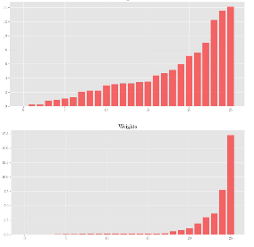
LASSO Regression
Total cost = measure of fit (RSS) + measure of the magnitude of coefficients
Total cost = RSS(w) + λ ( )
Ridge weights
LASSO pushes less important weights to 0
Can be used for feature selection!
LASSO weights

Slide 55
ElasticNet Regression
Total cost = measure of fit (RSS) + measure of the magnitude of coefficients
Total cost = RSS(w) + λ ( ) + λ ( )

Slide 56
ElasticNet Regression
Total cost = measure of fit (RSS) + measure of the magnitude of coefficients
Total cost = RSS(w) + λ ( ) + λ ( )
Ridge regularization
LASSO regularization

Slide 57
Regression Modeling
Linear regression – Ridge
Linear regression – LASSO
ElasticNet regression
Bayesian regression
Support Vector regression
Random Forest
AdaBoost
XGBoost

Slide 58
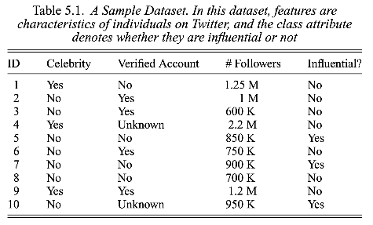
Trees and Forests

Slide 59
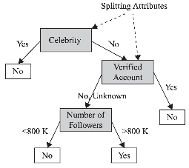
Trees and Forests

Slide 60
Trees and Forests
Non-leaf nodes denote tests on attributes

Slide 61
Trees and Forests
Branches denote outcome of the tests

Slide 62
Trees and Forests
Leaf nodes hold class labels

Slide 63
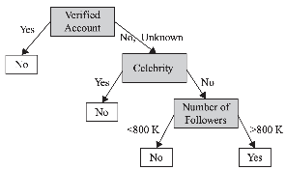
Trees and Forests

Slide 64
References
Data Mining: Concepts and Techniques, 3rd edition, by Jiawei Han, Michelin Kamber, and Jian Pei
A Beginner’s Guide to Regression Analysis in Machine Learning, by Aqeel Anwar
Ridge & Lasso Regression by Deep Patel

Slide 65
Summary

